Slide 1




Welcome to
CSA2002 INTRODUCTION TO DRONES
G.GANESAN, B.E (CSE)., M.E (CSE)., M.S(IT).,MISTE.,
SENIOR TEACHING FELLOW,
SCHOOL OF CSE.
+91-9500234437
ganesan.g@vitbhopal.ac.in

Slide 2
Course Content
Date: 24-01-2023 Time: 10.05am – 11.35am
Connectors
Frames

Slide 3
Connectors
Connectors are interfaces for routing power, data, and signals to and from different subsystems within the platform.
Route between UAV power and control systems, guidance systems, GNSS/INS and integrated or external payloads such as laser scanners, LiDAR and thermal or visual cameras.
Choosing a connector for a particular UAV application, depends on the design requirements.

Slide 4
Connectors - Requirements
Size, Weight and Power (SWaP): Lightweight and Compact (small form)
- Payload, fuel, fly for longer.
- Small UAVs
2. Environment and Durability: Variety and harsh environment conditions.
- High vibration and shock environments.
Rough landing and heavy vibration – High sock and vibration tolerance
Weather conditions – Airborne particles – sand, ash, dust, rain, temp
– sealing and protection ratings.
Operating range: -55 to +200 degrees Centigrade.
Electromagnetic Interference and Pulses (EMI and EMP): Shielding
necessary.

Slide 5
Connectors - Requirements
3. Performance: Signal degradation is the issue in high-speed applications.
- Connectors are capable of transferring large amount of
high-resolution video at ever-increasing speeds.
- Highly insulating materials, allow airflow to protect from melting.

Slide 6
Connector - Types
Medium or High altitude Connectors
Custom and COTS (commercial off-the-shelf) connectors are in a variety of form factors, such as Circular, Rectangular/ Strip.
Technology standard form factors such as USB, Ethernet and D-sub.
OEMs (Original Equipment Manufacturers) – MIL-SPEC or MIL-STD – which are meet the specification factors such as Vibration, Durability, Corrosion, and Temperature.

Slide 7
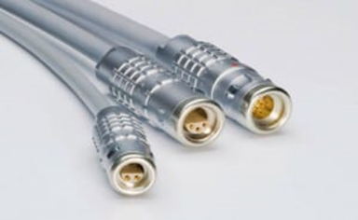
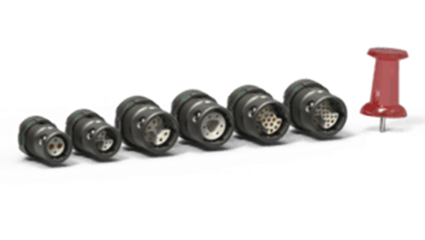
Connector - Types
Coupling and Locking Methods:
Plastic or metal shells.
Metalized composite shells providing lightweight and durable and reduce overall weight.
Aluminum-Higher-end to provide EMC protection.
Ruggedized Push-Pull:
Shell material used for connector bodies.
Provides both protection and Strength, but add weight.
Fischer:
Rugged and mission-critical applications.
Available: push-pull, screw lock, and quick release.

Slide 8
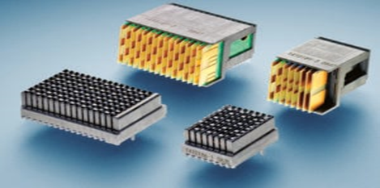
Connector - Types
TE Connectivity:
Lightweight, rugged interconnect tech.
For Unmanned vehicles like: UAV, UGV, UUV.
High performance – To absorb high levels of
vibration, shock and impact.
Nicomatic:
Power and Video transmission.
MIL 83513 performance –> 1.27mm pitch of rugged Micro connectors.

Slide 9
QUERIES?

Slide 10
FRAMES

Slide 11
Frames
Drone’s body skeleton is called frame. It helps to mount the motors, battery, and their parts on it. The frame is used to built copter or glider.
Ex: Tricopter – size is small, 3-motors, 3-propellers, 3-ESC, etc.
Material: Carbon, Wood, Metal, Plastic, Fiberglass.
Choosing: Light and Strong – Carbon Fiber (high cost)
- Plastic / Acrylic (medium cost)
We keep the frame balanced and the center of gravity when flying the drone.

Slide 12

Frames – How to built?
The thrust of the motor after mounting on the frame is really important.
Thrust tells – float in the air or fall down or become imbalanced.
Thrust of a Motor:
If ‘P’ is the payload capacity of the drone, then the motor thrust ‘T’ is:
Where, M – No.of Motors, W – Weight of the drone, H-Hover throttle in %.
Therefore, P = T x M x H - W

Slide 13
Frames - Types
Monocopter
Bicopter
Tricopter: T Y
Quadcopter: + X H
Hexacopter: X Stretch
Octocopter: + X

Slide 14
Frames – Pros and Cons
1. Monocopter: Up and Down only. Increase the motor helps to stabilize the
drone. Yaw, Rudder, and Roll motions are not possible.
2. Bicopter: Varying speed of motor independently to generate total thrust.
3. Tricopter: Different look for a UAV. Forward motion. Low cost.
Not symmetric ->Servo needs to be mounted along the axis that
leads rear arm is more complex, therefore not all FC support this
configuration.
4. Quadcopter: Simplest construction and quite versatile. The arms/motor are
symmetric about two axes. All FC can work.
No redundancy. If there is a failure in system (motor/propeller), the
craft going to crash.

Slide 15
Frames – Pros and Cons
5. Hexacopter: Add 2 more arms and motors -> Lift more payload.
If a motor fail, a chance to land rather than crash.
Moduler -> use the same motor and support arm.
All FC can support.
More expensive and larger.
Adding motor/arms -> increase the copter weight -> battery
6. Octocopter: Increased redundancy -> more motors = more thrust
More motors = more price and larger battery pack.

Slide 16
Frames – Guidelines
Step 1: See what materials and machining processes you have at your disposal.
If you do not have much as far as machining capabilities, are not comfortable with tools, or simply want a more professional frame, then consider purchasing a frame kit.
A decent frame can be made with basic tools and materials, but determining areas where it may be structurally weak, resonate (cause vibration) or may be misaligned take a keen eye and experience
If you plan to create a custom frame, take into consideration all of the
mounting which needs to be done; motors, electronics etc. and plan accordingly.

Slide 17
Frames – Guidelines
Step 2: List all of the additional (non-essential) parts you plan to add
Additional items might include: one, two or three axis camera gimbal, parachute, onboard mini computer, payload, long-range electronics (tend to be larger / heavier), floatation etc.
This list of additional / non-essential parts will give you an idea of the size of drone you will need, and add to the total weight calculation (to be done later).
Step 3: Get a rough idea of the size of frame you want
A larger frame does not necessarily make the drone more capable, and a smaller frame does not mean the drone will be any less expensive
A drone between 400 and 600mm is suggested for beginners.

Slide 18
Frames – Guidelines
Step 4: Design, build and test the frame
If you opted to purchase a frame kit, you should not have much to worry about in regards to durability / rigidity / assembly.
If you chose instead to design and build your own frame, it's important to test its durability, check the weight and see if it can withstand vibration.
Consider using a CAD software (many are free such as Google Sketchup) to design the frame and ensure dimensions are correct.

Slide 19
Thank You
&
Queries?

